Slide 1
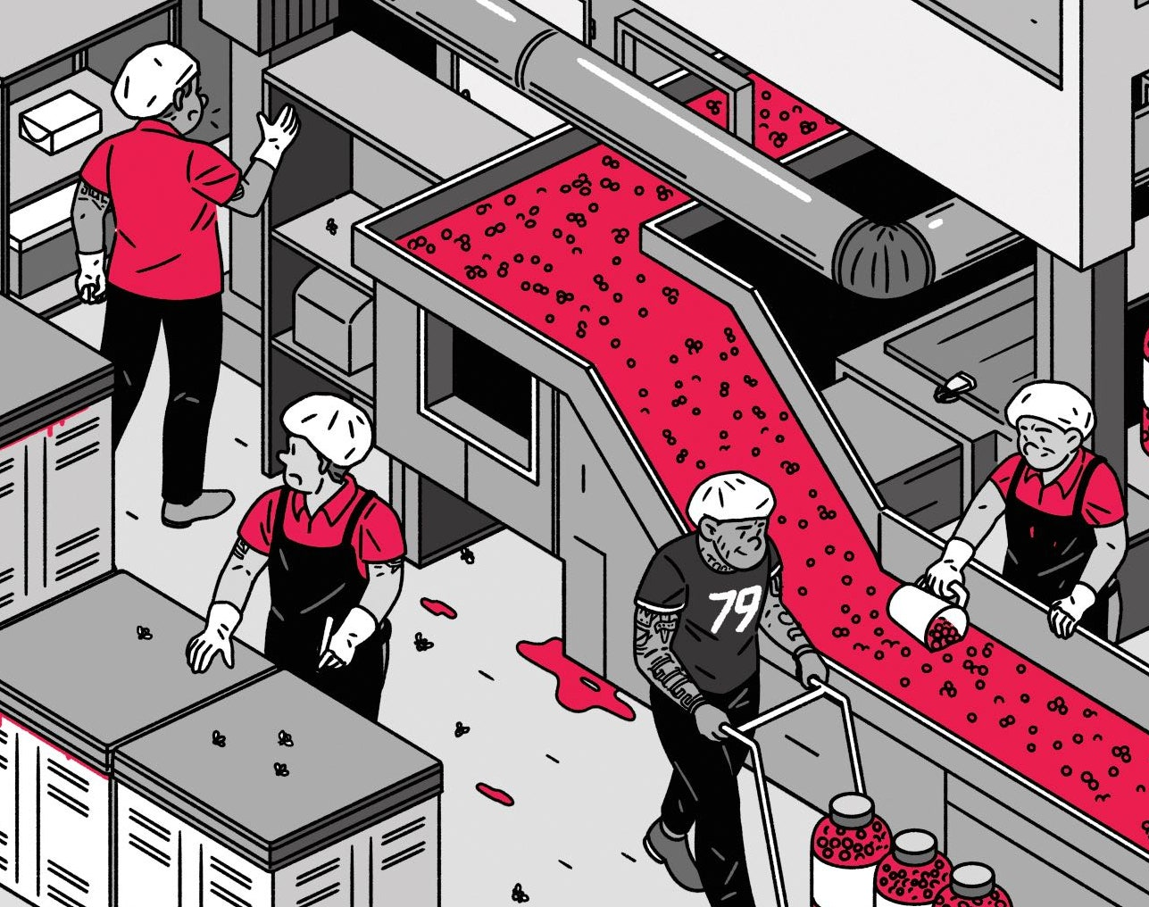
National Cranberry Case
MeghashreE Maddihally Nagoji

Slide 2


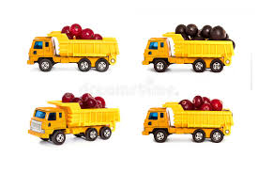
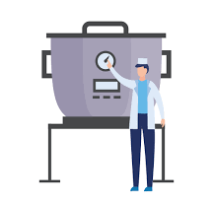


PROBLEM
Loaded truck waiting
Bottleneck dryers
Overtime by worker
Inaccurate berry grading

Slide 3

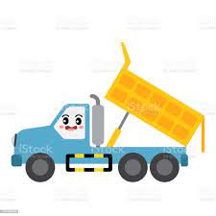
ANALYSIS
Huge Investment in New Kiwanee dumper
To reduce truck waiting time
But neither truck wait time nor overtime cost was reduced

Slide 4


SHORT TERM RECOMMENDATION
Double the shift by adding another 8 hours which reduces overtime to ~5 hours
Using dry bins as wet bins. Converting 10 dry bins to wet bins reduces truck wait time

Slide 5
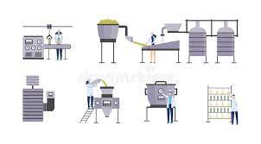

LONG TERM RECOMMENDATION
Add a new dryer. Costs $60k to set-up and leads to aggregate savings of ~$175k
Install light metering system. Costs ~$100k to set-up and leads to aggregate savings of ~$250k

